Slide 1


Master of Technology (IS)
Individual Project
HAN DONGCHOU FRANCIS | A0195414A
Candidate Screening System
Candidate Screening System
Project Report

Slide 2
Contents
Executive Summary
Business Problem Background
Project Solution
Implementation
Project Validation

Slide 3
Executive Summary
In the world of recruitment, matching the right talent to the vacancy is always a challenge. When a vacancy is posted, there will usually be many applications and the challenge is the arduous task of sieving through the sea of profiles.
For this reason, I have come up with a simple application to help recruiters screen the candidates that are submitted for the available positions. The candidates will first fill up a questionnaire as part of the job application. Based on the input by the candidate, the application will determine his/her suitability and decide the next step. This next step will either be a review by the recruiter or be a dropout from the workflow due to unsuitability.
The purpose for this application is to cut down the time that the recruiters take to screen the profiles.
This application makes use of the KIE Workbench for the workflow, as well as the Decision Tree to execute the main logic.

Slide 4
Business Problem Background
Recruiters spend a lot of their time matching the right candidate for a particular vacancy. This has become increasing challenging as more variations in skillsets emerge in the new information centric economy.
Filtering through the hundreds, and sometimes thousands, of profiles is one reason that many recruiters spend less time on value added tasks like interacting with suitable candidates and keeping up with hiring managers’ requirements.
Imagine the scenario where we may end up placing the less suitable candidates in the job positions, or reaching out to the suitable ones too late. This will result in reduced potential for the business and lower productivity for the employees.
We need a better way to streamline the screening process, for which the requirements are spelled out in a job scope. And we need to be able to filter through the many profiles quickly and reach out to the right candidates before they move on to other pastures.

Slide 5
Project Solution
This application performs a quick screening by getting the candidate to fill in some vital information about himself/herself.
The KIE Workbench is employed to provide the workflow as well as the Decision Tree which comes with the built-in logic execution function.
Based on the information entered, the application will determine if there is a match. If the result is positive, the profile will go on to a recruiter for review. Otherwise it will exit the workflow and be dropped.
Due to time constraint, the application is deliberately made simple. However, it can be extended with added data objects and workflow details to suit an actual recruitment situation.
Notes:
One in four young Singaporeans show signs of depression. Yet half of people affected by depression are not even seeking any help. The reason for not getting help? Fear of ridicule.
Some find hard it to reveal their depression because of stigma. But lately, more young people are breaking the silence to seek help for the condition. IMH treated 600 people youths between 20 to 29-years-old last year alone.
And one out of four people admitted to suffering from multiple symptoms of depression in a recent survey of youths aged 18 to 25. The study was conducted by students from Wee Kim Wee School of Communication and Information in NTU.
We know that depression may lead to suicide. But other times, its sufferers become less productive and are more at risk for other diseases.
The latest statistics on depression don’t paint a pretty picture of progress but it shows that the condition is more common than we think. Yet the stigma surrounding it walls off the victim who often suffers in silence.

Slide 6
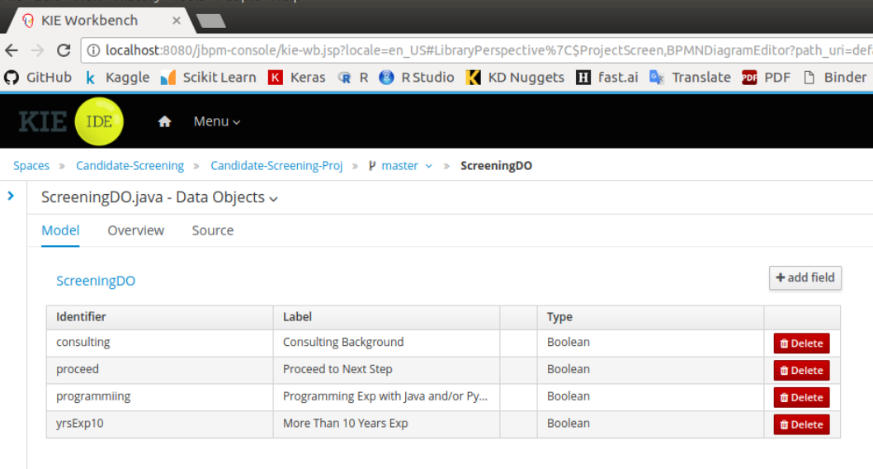
Implementation
Data Objects
In this simple setup, only 4 data objects are created.
consulting – whether the candidate has a consulting background
proceed – flag indicating ‘proceed’ to hire
programming – possess programming experience
yrsExp10 – more than 10 Years of Experience
The idea behind this setup is to match a suitable candidate who would meet some requirements across the 3 main factors (1) Consulting background, (2) Programming skills, (3) Extensive experience.

Slide 7
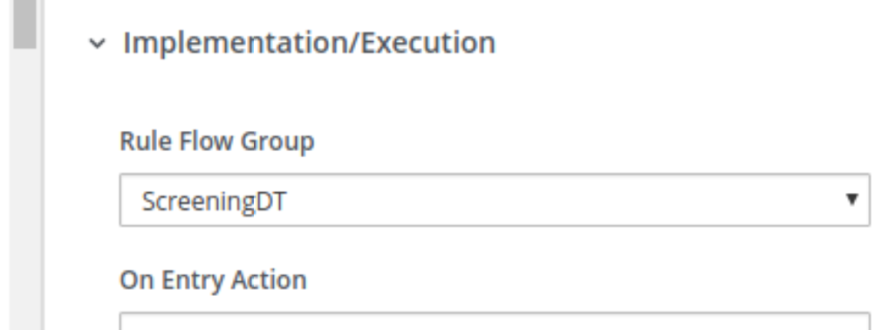
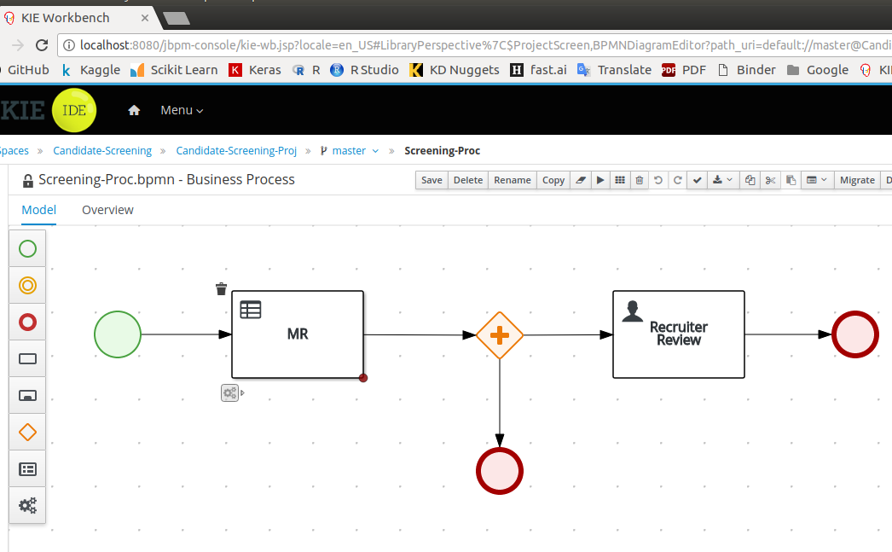
Implementation
WORKFLOW
The workflow has a Business Rule task to execute the logic using the Decision Tree, as per the Rule Flow Group setting below.
After this step, the Recruiter will do a review if the result is a match.
Otherwise, the profile goes out of the workflow and ends.

Slide 8
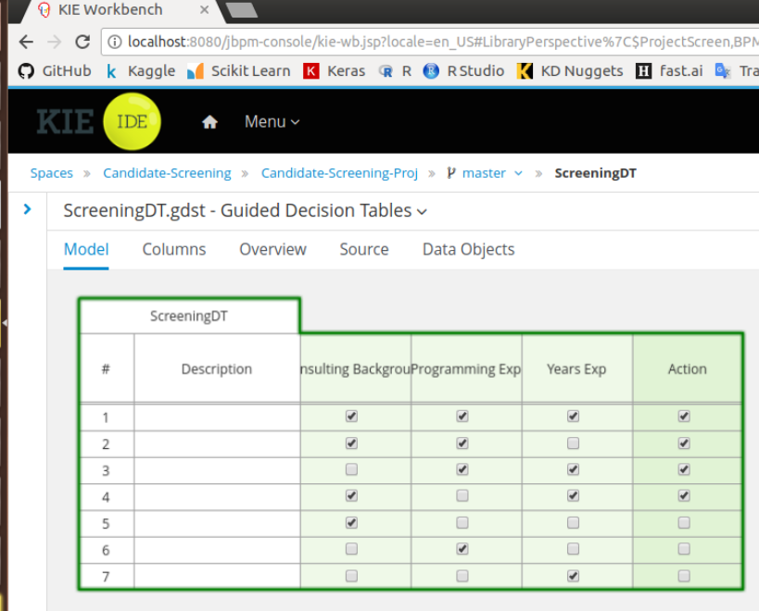
Implementation
Decision Tree
Using the Decision Tree, the filtering is carried out based on the logic. The value for Proceed is default to False.
IF Consulting Background
AND Programming Skills
AND >10 Years Experience
THEN Proceed
2) IF Consulting Background
AND Programming Skills
THEN Proceed
3) IF Programming Skills
AND >10 Years Experience
THEN Proceed

Slide 9
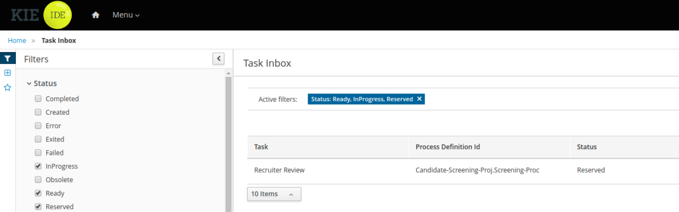
Project Validation Executing the Workflow
The user iss-barry logs in to execute the workflow with the screen showing the status below.
He will Start the process, and then Complete it to end the workflow.
For the test scenario, a positive set of inputs were given such that the Proceed flag becomes True.

